Slide 1
Diabetic Retinopathy Detection
COVENTRY UNIVERSITY
Presented By: Aleena Alby 1st Supervisor : Prof. James Brusey
2nd Supervisor : Dr. Fei He
Date : 6 Dec 2022

Slide 2
COVENTRY UNIVERSITY
1
Project Overview
Build cnn and transfer learning models
Model comparison
Data Collection
1
3
5
2
4
6
Data pre-processing
Fine tune model
Result evaluation

Slide 3
COVENTRY UNIVERSITY
2
Major Platforms & Libraries
Jupyter notebook
Python
Tensorflow
scikit-learn
Google Colab pro
Keras
Matplotlib

Slide 4
COVENTRY UNIVERSITY
4
Objective and scope
To develop various deep learning models for the detection of diabetic retinopathy.
Construct models for CNN and transfer learning, and then evaluate them using evaluation metrics such as accuracy, recall, f1-score, and precision.
Deliverables: An effective model for identifying diabetic retinopathy disease

Slide 5
COVENTRY UNIVERSITY
3
Related work
2022
2021
Performances of CNN Architectures on Diabetic Retinopathy Detection Using Transfer Learning ( [1] Kaya and Saritas)
Assessed the ResNet18, GoogleNet, and SqueezeNet CNN architectures.
Dataset : DRIVE dataset (400 Images)
Diabetic Retinopathy Diagnosis and Categorization Using Deep Learning - a Review ( [2] Pathak et al.)
Using a SVM method, CNN classifiers, and ANN classifiers
Dataset: IDRiD, High-Resolution Fundus (HRF) Image Database and Kaggle dataset

Slide 6
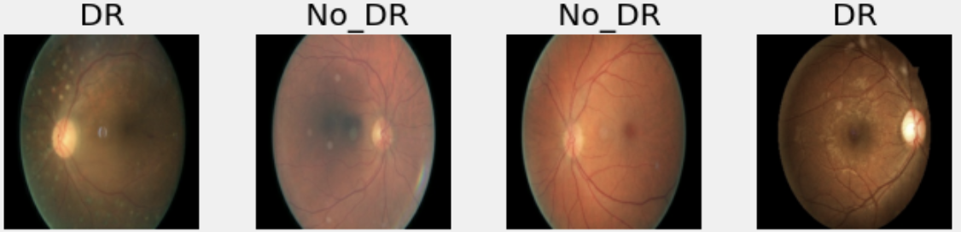
COVENTRY UNIVERSITY
5
About Data
Dataset: Retinal images provided by EyePACS downloaded from Kaggle.
For each image, a left and right field is provided.
IMAGE CLASSES | LEVEL
No DR | 0
Mild | 1
Moderate | 2
Severe | 3
Proliferative | 4

Slide 7
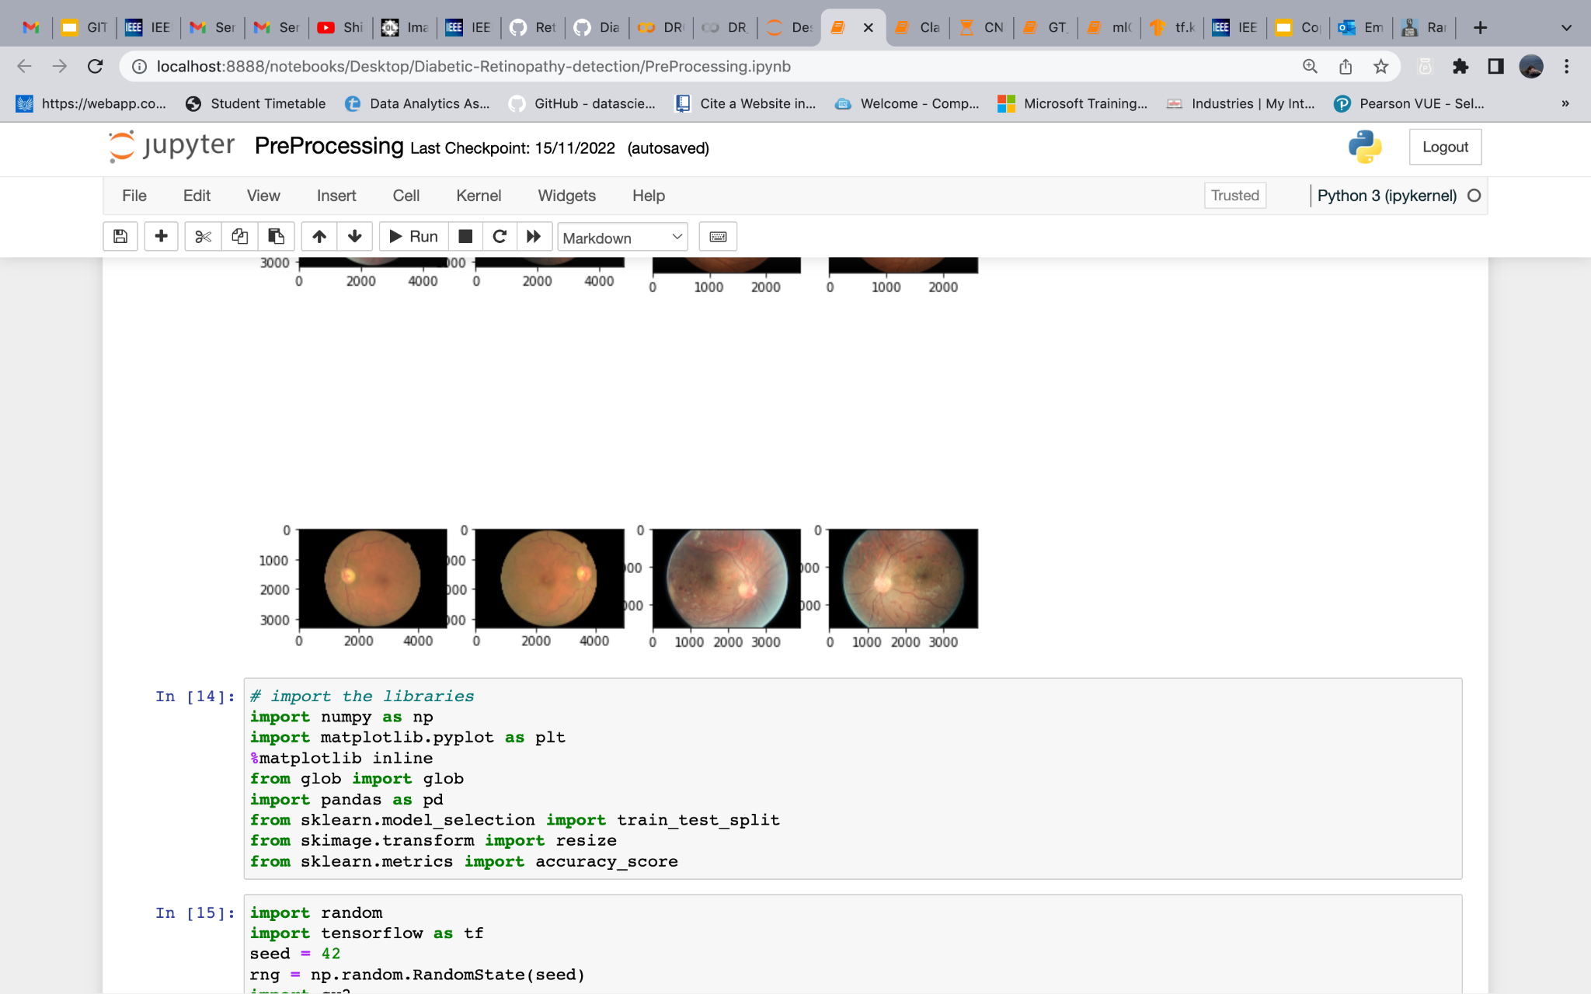
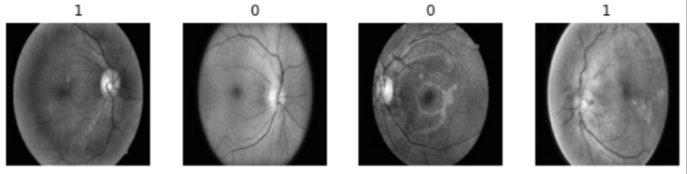
COVENTRY UNIVERSITY
6
Methodology
DATA COLLECTION : Dataset contain 35,126 set of images with 5 classes.
2. IMAGE PRE-PROCESSING: Images resized to 256 * 256 pixels.
Images with 40% black and white pixels removed.
To improve the contrast of the image CLAHE method is used.
The dataset was imbalanced, so a under-sampling strategy is implemented.
Before CLAHE
After CLAHE

Slide 8
COVENTRY UNIVERSITY
6
Methodology - continue..
3. BUILD DL MODELS: Models used are CNN, DenseNet50, EfficientNetV2L, ResNet50
4. DEPLOY MODEL
5. MODELS EVALUATION: Analyze models performances using evaluation metrics

Slide 9
COVENTRY UNIVERSITY
7
Models Evaluation
Models | Accuracy % | Recall % | F1 score %
EfficientNet V2L | 71 | 62 | 62
DenseNet201 | 67 | 53 | 48
ResNet50 | 67 | 54 | 49

Slide 10
COVENTRY UNIVERSITY
8
Limitation and future scope
Limitation
Limitation of this work is that the dataset was an imbalanced dataset.
Future Scope
This study has effectively shown that boosting image quality increases accuracy. It is recommended that more study be done to look into alternative image enhancement features.
More data preprocessing steps could be implemented.
Other model could also be explored.

Slide 11
COVENTRY UNIVERSITY
9
Conclusion
Experimental findings demonstrate that the model trained well. Due to the lack of more images in DR category, validation produced average result.
With a recall score of 0.62, the EfficientNet V2L model was the better one.

Slide 12
COVENTRY UNIVERSITY
10
References
[1] Kaya, Esra, and Ismail Saritas. 2022. “Performances of CNN Architectures on Diabetic Retinopathy Detection Using Transfer Learning.” In 2022 57th International Scientific Conference on Information, Communication and Energy Systems and Technologies (ICEST), 1–4. https://doi.org/10.1109/ICEST55168.2022.9828576.
[2] Pathak, Ketki C., Riddhi B. Shah, Reshma R. Tharakan, Bhavya N. Patel, and Dhruvi C. Jariwala. 2021.
“Diabetic Retinopathy Diagnosis and Categorization Using Deep Learning - a Review.” In 2021 5th International Conference on Intelligent Computing and Control Systems (ICICCS), 1063–69. Https://doi.org/10.1109/ICICCS51141.2021.9432312.

Slide 13
Thanks!

